Slide 1
Introduction to Accessibility
TSO training: 4/10/2018
support.cc.gatech.edu

Slide 2
WHY ACCESSIBILITY?
Legal: We are required to follow 508 & WCAG 2.0 AA. AMAC overview slides & GT Accessibility Policy (slides).
Communication: is more effective across different channels (including mobile) and different abilities.
Marketing: often improves SEO (search engine optimization).

Slide 3
Types of Disabilities
Auditory
Motor
Cognitive
Seizure
Visual

Slide 4
Keyboard and Mobile
Interaction can be difficult on various devices.
*Video explanation: https://www.w3.org/WAI/perspectives/keyboard.html
Size matters
Video explanation: https://www.w3.org/WAI/perspectives/controls.html

Slide 5
Images AND COlorS
Images can enhance comprehension, and are especially helpful for people with dyslexia, ADHD, and other cognitive or neurological challenges.
Poor use of images or color can be distracting and even prevent some people from understanding your content.
Example Experience of Dyslexia: http://www.dailymail.co.uk/sciencetech/article-3480257/What-s-REALLY-like-read-dyslexia-Simulator-reveals-letters-words-appear-people-condition.html

Slide 6
COLORS: HIGH CONTRAST
Use a high contrast color scheme.
This is especially important so that text and background do not blend together.
Video explanation: https://www.w3.org/WAI/perspectives/contrast.html
Tool 1: https://webaim.org/resources/contrastchecker/
Tool 2: https://developer.paciellogroup.com/resources/contrastanalyser/

Slide 7
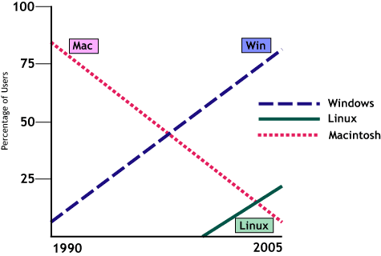
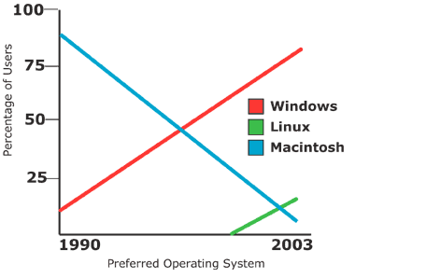
COLORS: Alternative I.D. Needed
Provide alternatives for color coding, especially essential for those with color-blindness.

Slide 8
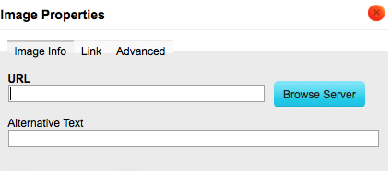
IMAGES: Alternative text basics
Software cannot translate images into words for those having documents and webpages read aloud to them.
We must translate those images, by providing “alternative text” or “alt tags” that describes them.
Tip: Do not use the words Image, Picture, Photo, etc. in your alternative text.
Tip: Inspect element for image in your web browser.

Slide 9
IMAGES: CONTEXT AND PURPOSES
Provide text alternatives (less than 120 characters) based on the purpose of the image:
Embedded text = avoid
Informative = essential information presented
Decorative = leave blank
Functional = describe functionality (e.g. print page or what it links to)
Complex = provide full-text equivalent (e.g. diagrams)
Explanation of image types and their alternative text: https://webaim.org/techniques/alttext/

Slide 10
IMAGES: CONTEXT COMPARISON
Website content = “Acorns”
Horticulture class = “Acorns of Quercus georgiana M.A. Curtis”
Image is a link = “International Oak Society”
Image is decoration = “”

Slide 11
IMAGES: EMBEDDED TEXT and SIZE
In general, do not embed text inside an image, as software cannot read it and it will often be unreadable when scaled for mobile.
If you do embed text, you must copy the same words as the Alternative Text.

Slide 12
IMAGES: Banner Alternative TexT
If I hadn’t taken this course I would never have figured out that I had a passion for this, says Nylah Julmice, standing in front of sound waves and code samples. (111-162 characters)

Slide 13
IMAGES: ALTERNATIVE TEXT POP QUIZ
What alternative text could you provide for this image?

Slide 14
IMAGES: ALTERNATIVE TEXT POP QUIZ
What alternative text could you provide for this image? And could you read it on a mobile device?

Slide 15
IMAGES: ALTERNATIVE TEXT POP QUIZ
What alternative text could you provide for this image? And how would you navigate it without a mouse?

Slide 16
STRUCTURE AND Readability
Making something easier to read is similar on websites and in documents.
No one reads: http://uxmyths.com/post/647473628/myth-people-read-on-the-web
A key way to make these documents readable is by using the correct structural and hidden pieces.
Video explanation of comprehension/language: https://www.w3.org/WAI/perspectives/understandable.html
Video explanation of layout: https://www.w3.org/WAI/perspectives/layout.html

Slide 17
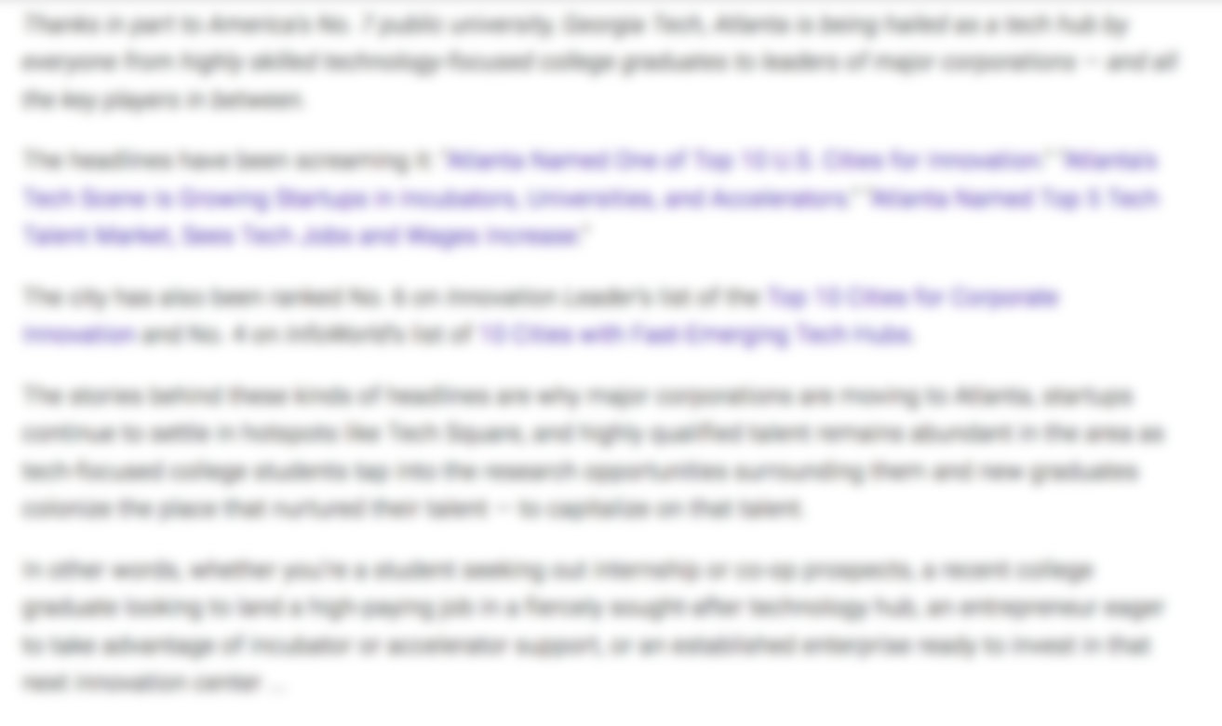
Structure: Clear vs. Blurry 1
What visual clues do you get just from scanning this document?

Slide 18
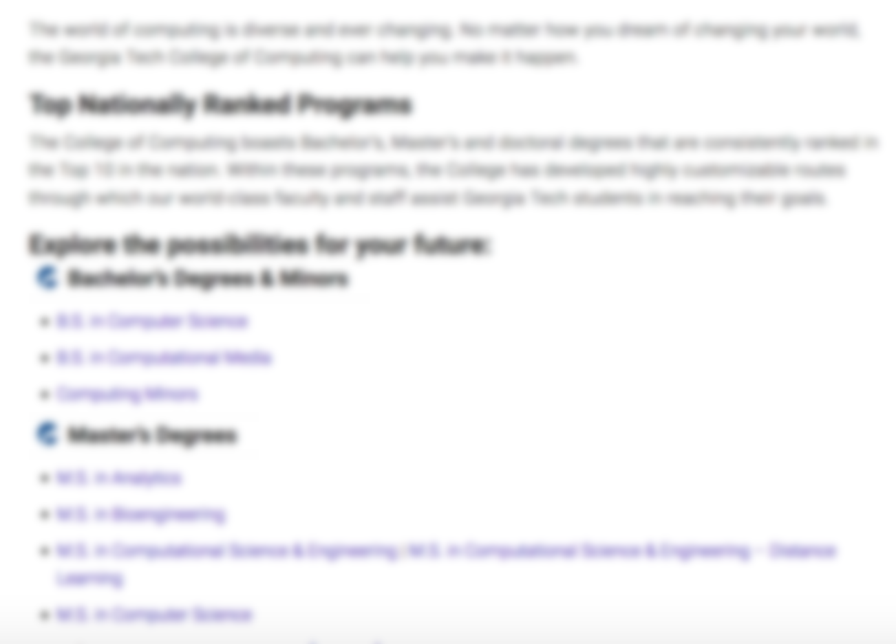
Structure: Clear vs. Blurry 2
What visual clues do you get just from scanning this document?

Slide 19
Structure: HEADINGS AND LISTS
Headings give an overview of the page, but are not the same as visual changes in font size or color. Likewise, lists are more than just circular images at the start of a line.
Screenreaders often navigate a page by listing all the Headings.
Also incredibly helpful for those with cognitive disabilities (such as ADHD), or busy people who don’t read, but just quickly scan the page.
Use heading levels sequentially. For our Drupal/Mercury sites, start with h3 (because we already use h1 & h2). You can use h3 multiple times, if content is at the same “level”.

Slide 20
Structure: Titles, MENUS and Links
Screenreaders often navigate a page by listing all the links.
Links, generally, should:
Make sense out of context
Describe where they go
Be unique
Links should not:
Use the URL text
Use the words “Click here”, “Learn more”, “Read more”, “Email me”, etc
Menu labels should be very short, but clearly hint at the page to which they direct the user.
Page Titles can be longer and more descriptive than menu labels. They should always make sense out of context (for increased search engine optimization), and should not change once set.

Slide 21
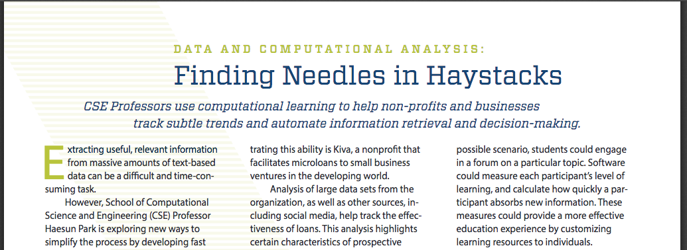
Structure: READING Order
Reading order or sequence is especially important for tables and for PDFs.
Columnar examples:
https://www.cc.gatech.edu/sites/default/files/documents/CSE-AnnualReport2016.pdf
https://www.cc.gatech.edu/sites/default/files/CSE-SPP-Brochure-Full.pdf

Slide 22
TABLES: KEEP IT SIMPLE
Tables are for data: do not use them for layout.
Avoid nested tables, as they are not read well by software.
Leave width blank or use a percentage (e.g. 95%), for scaling on mobile.
Web Accessibility Tutorial on Tables from W3C

Slide 23
TABLES: RELATIONSHIPS
Screenreaders do not have the visual cues that communicate relationships, so special code must be added to give those cues.

Slide 24
Tables: READING ORDER
Should make sense when read from top to bottom and left to right.

Slide 25
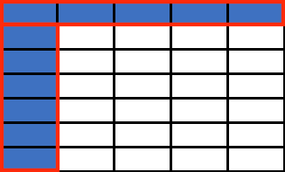
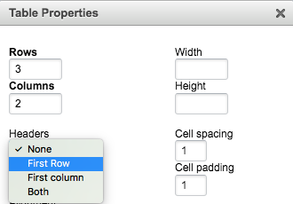
TABLES: HEADERS
Must have at least 1 row or 1 column designated as a header.
The text editor adds the <th> code when you set the Headers option under Table Properties.

Slide 26
TABLES: CAPTION vs. SUMMARY
Always provide a visible Caption, either a title or brief description of the content of the table.
The Summary invisibly describes the structure of a table and may not be needed.

Slide 27
DOCUMENTS and PDFS
A lot of the same rules apply as do to webpages. Learn how to use headings, reading sequence, and etc. in Microsoft Word or Adobe Acrobat Pro.
Resources:
https://www.hhs.gov/web/section-508/making-files-accessible/index.html
http://www.amacusg.org/wag/images/1/16/Slides_81-156_AccessibleDocs.pdf
http://www.amacusg.org/wag/images/c/ca/KarenMcCallAccessibleWordToPDFJun2017.pdf

Slide 28
VIDEOs: CAPTIONS AND TRANSCRIPTS
Who do captions help? People who:
Have no or little hearing
Are non-native speakers
Have ADHD
Are in a very loud or very quiet place
Video explanation of caption importance: https://www.w3.org/WAI/perspectives/captions.html
Tips:
Livestreaming (synchronous video) is almost impossible to make accessible, without specialized software and paid live caption experts.
Automatic captions are often wrong.
If no captions, upload both a transcript and a video description.

Slide 29
VIDEOS: Caption Costs and Guides
Captions are not expensive. Likely will only be a few dollars per minute of video from these vendors:
https://webmasters.gatech.edu/handbook/amac-campus-accessibility-organization
http://www.3playmedia.com/customers/case-studies/georgia-tech/
You can also add your own captions to hosted videos:
Add captions to YouTube videos
Add captions to Kaltura videos

Slide 30
VIDEOs: CAPTION EXAMPLE 1
Automatic captions can be embarrassingly inaccurate.

Slide 31
VIDEOs: CAPTION EXAMPLE 2
Automatic captions lack punctuation.

Slide 32
VIDEOs: CAPTION EXAMPLE 3
Manual captions are more accurate, easier to read, and better represent us to the world.

Slide 33
ADDITIONAL RESOURCES
https://www.w3.org/WAI/tutorials/
http://www.amacusg.org/wag/Main_Page
http://wave.webaim.org/
https://fae.disability.illinois.edu/abouts/
https://webaim.org/standards/508/checklist
https://webaim.org/articles/cognitive/
https://www.adobe.com/accessibility/products/indesign.html
http://diagramcenter.org/table-of-contents-2.html#contents
http://www.amacusg.org
https://www.webpagefx.com/tools/read-able
https://webmasters.gatech.edu/kb/writing-web-guide
https://www.youtube.com/watch?v=EpyhtQYJqD4
http://www.espn.com/core/toolkit/page/webAccessibilityGuide
https://help.twitter.com/en/using-twitter/picture-descriptions
https://www.nngroup.com/articles/how-users-read-on-the-web/

Slide 34
Q & A
Do you have questions?

